Slide 1
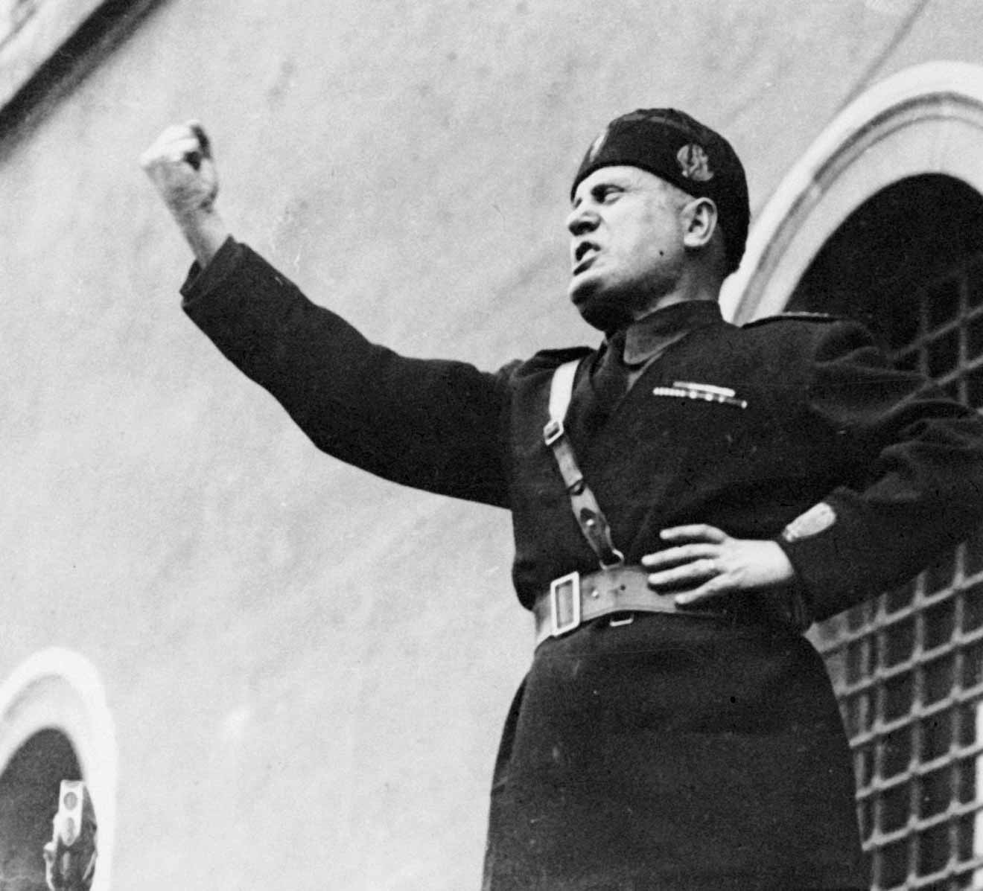
Benito Mussolini
Article Rights Violated

Slide 2
Article 2
Everyone is entitled to all the rights and freedoms set forth in this Declaration, without distinction of any kind, such as race, colour, sex, language, religion, political or other opinion, national or social origin, property, birth or other status. Furthermore, no distinction shall be made on the basis of the political, jurisdictional or international status of the country or territory to which a person belongs, whether it be independent, trust, non-self-governing or under any other limitation of sovereignty.
-

Slide 3
Article 18
Everyone has the right to freedom of thought, conscience and religion; this right includes freedom to change his religion or belief, and freedom, either alone or in community with others and in public or private, to manifest his religion or belief in teaching, practice, worship and observance.

Slide 4
Article 1
ll human beings are born free and equal in dignity and rights .They are endowed with reason and conscience and should act towards one another in a spirit of brotherhood.

Slide 5
Article 20
(1) Everyone has the right to freedom of peaceful assembly and association.
(2) No one may be compelled to belong to an association.

