Slide 1
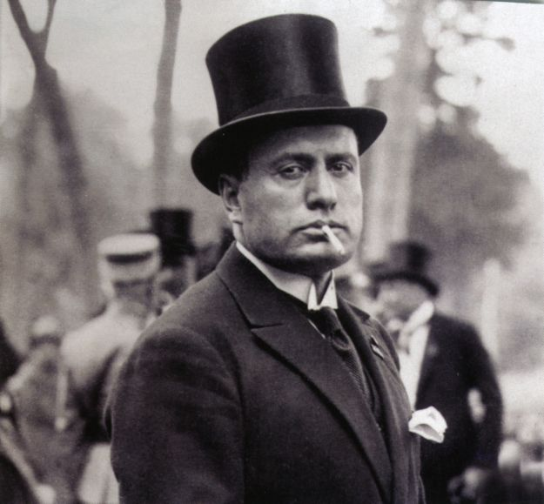
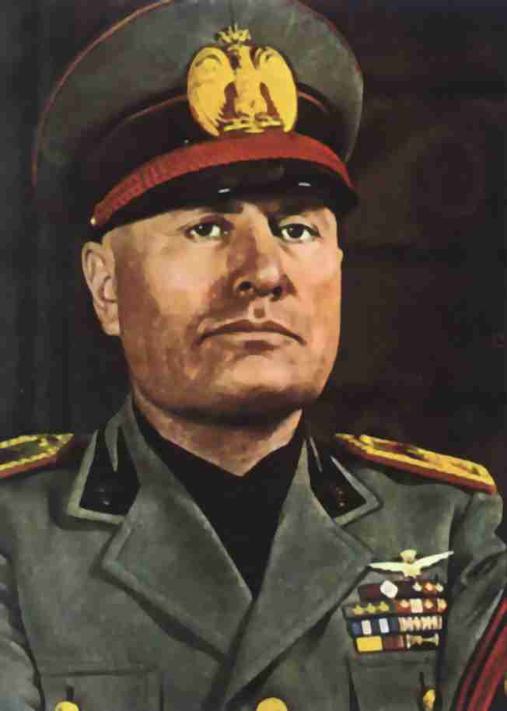
Benito Mussolini
A Twentieth Century Macbeth???

Slide 2
Macbeth vs. Mussolini: Quote #1
Thou hast it now: king, Cawdor, Glamis, all,
As the weird women promised, and I fear
Thou played’st most foully for ’t. Yet it was said
It should not stand in thy posterity,
But that myself should be the root and father
Of many kings. If there come truth from them—
As upon thee, Macbeth, their speeches shine—
Why, by the verities on thee made good,
May they not be my oracles as well,
And set me up in hope? But hush, no more.
(Act 3. Scene 1. Lines 1-10) (Banquo)

Slide 3
Quote #1 Explained
Macbeth
Mussolini
Banquo reminds Macbeth that the Witches prophecy about him becoming thane of Cawdor came true. He also reminds Macbeth of the witches second prophecy, which was Banquo’s sons and grandsons becoming king, and not Macbeth’s descendants. He suggests that maybe that prophecy will become true as well. Macbeth has Banquo murdered later in the story line when he discovers Banquo is a political opponent
Mussolini organized a Para-military known as the “Blackshirts” who fought against and murdered political opponents (i.e. Socialists, Catholics, Protestants), which helped increased fascist influence. People who chose not to follow Mussolini and his fascism were brutally fought against, and most likely murdered

Slide 4
Macbeth vs. Mussolini: Quote# 2
What beast was ’t, then,
That made you break this enterprise to me?
When you durst do it, then you were a man;
And to be more than what you were, you would
Be so much more the man. Nor time nor place
Did then adhere, and yet you would make both.
They have made themselves, and that their fitness now
Does unmake you. I have given suck, and know
How tender ’tis to love the babe that milks me.
I would, while it was smiling in my face,
Have plucked my nipple from his boneless gums
And dashed the brains out, had I so sworn as you
Have done to this.
(Act 1, Scene 7, Lines 47-60) (Lady Macbeth)

Slide 5
Quote #2 Explained
Macbeth
Mussolini
Lady Macbeth is a deeply ambitious woman who lusts for power. She becomes stronger than her husband, and she is very ruthless, and constantly urges Macbeth to murder Duncan, and take the crown. Macbeth has a bit of a conscience, but lady Macbeth's constant motivation fuels Macbeths ambition to kill Duncan.
Adolf Hitler became very impressed with Mussolini, and Italy’s military success when conquering Ethiopia. Mussolini was flattered that such a big successful man like Hitler was impressed with his work. It was Hitler’s admiration that motivated Mussolini to sign the alliance between Italy and Germany, and begin the Discrimination laws against the Jews in Italy

Slide 6
Macbeth vs. Mussolini Quote #3
Still it cried "Sleep no more!" to all the house: 39 "Glamis hath murder'd sleep, and therefore Cawdor 40 Shall sleep no more; Macbeth shall sleep no more.“
(Act. 2. Scene 2. Lines 38-40)

Slide 7
Quote #3 Explanation
Macbeth
Mussolini
Macbeth was selfish to kill Duncan in order to become king, but his conscience kicked in, because he knew that what he did was wrong. He stated after the murder that he will never sleep again.
Mussolini killed people without showing any remorse. If people chose to not follow him, the Blackshirts would have them killed

Slide 8
Macbeth vs. Mussolini Quote #4
Bring me no more reports. Let them fly all.
Till Birnam Wood remove to Dunsinane
I cannot taint with fear. What’s the boy Malcolm?
Was he not born of woman? The spirits that know
All mortal consequences have pronounced me thus:
“Fear not, Macbeth. No man that’s born of woman
Shall e'er have power upon thee.” Then fly, false thanes,
And mingle with the English epicures.
The mind I sway by and the heart I bear
Shall never sag with doubt nor shake with fear.
(Act 5. scene 3, lines 1-10)

Slide 9
Quote #4 Explained
Macbeth
Mussolini
This quote is a primary example of Macbeth’s arrogance, when he shares his believe that no man born of a woman can harm him
He believed that he was a 'new Julius Caesar'. He dreamed of a new Roman Empire, but he wanted it to be bigger and stronger. When he won the Second World War he called his new empire Greater Italy.

Slide 10
Works Cited
Macbeth Play
http://www.biography.com/people/benito-mussolini-9419443#awesm=~oBJZaQrHrUGFrk
http://www.bbc.co.uk/history/historic_figures/mussolini_benito.shtml
http://www.historylearningsite.co.uk/benito_mussolini.htm

