Slide 1
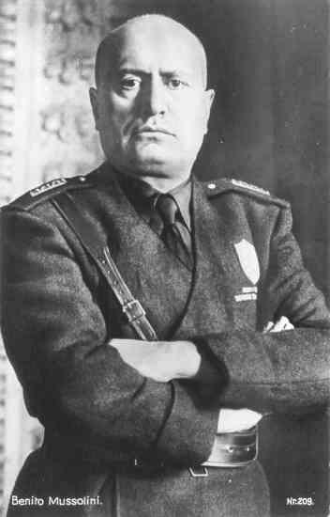
Who was Benito Mussolini?

Slide 2
Synopsis
born July 29, 1883 in Dovia di Predappio , Forli, Italy
Enthusiastic socialist as a youth
Brilliant public speaker
Founder of the Fascist party of Italy
Eventually made himself dictator and held all the power in Italy
Overextended his forces in the Second World war
Killed by his own people (1945)

Slide 3
Impassioned Socialist
- moved to Switzerland in 1902 to Promote Socialism
- quickly gained a reputation for his public speaking
- Caught the attention of Swiss authorities. Expelled from country.
- returned to Switzerland to promote a socialist agenda
- Became editor of the organizations newspaper called “Advanti,” which expanded his influence among many people

Slide 4
Rise to Power
- Originally expressed disapproval for Italy to join WW1
- Later recognized that the war would be an excellent opportunity for Italy to gain power
- His change in attitude repelled many fellow socialists, and was eventually expelled from his own organization
Joined Italian forces in 1915
Reached a rank of corporal before becoming wounded and discharged from the army

Slide 5
Rise to Power
- After war, Criticized Italian government for weakness at treaty of Versailles
- organized several right-wing groups into a single force, creating the fascist party
- the movement proclaimed opposition to social class discrimination and supported nationalist sentiments, hoping to raise Italy to levels of its great Roman past.

Slide 6
Rise to Power
- Mussolini organized a para-military known as “The Blackshirts,” who fought against and murdered political opponents
- Italy fell into political chaos by 1922
- Mussolini dismantled all democratic institutions, and by 1929, made himself dictator.
- reduced unemployment, making him very popular with people

Slide 7
Military Benefits
- Invaded and took over Ethiopia in 1935, making Ethiopia apart of the new Italian empire
- Adolf Hitler was very impressed with Italy’s military success, and established a relationship with Mussolini
- The two psycho’s signed a military alliance aka “Pact of Steel”
- Instituted discrimination policies against Jews in Italy

Slide 8
Fall of Italy
- Winston Churchill and Franklin D. Roosevelt formed a plan to take Italy out of the War, and force Germany to move troops to the Eastern front against the Soviet Union
- Mussolini was forced to resign and he was arrested
- German commando’s later rescued him
- Mussolini moved his government to northern italy
- Rome was liberated by allied forces, who marched to take control of italy

Slide 9
Mussolini’s Demise
- Mussolini and his mistress attempted to escape to Switzerland
- They were caught by the Italian underground on April 27, 1945m and executed the following day
- Their bodies were hung on display in a local plaza in Mezzegra, Italy
- Many Italian’s kicked, and spat on the body of Mussolini

